Slide 1
Object-Oriented Programming
FORTRAN 2003

Slide 2
Object-Oriented Programming in Fortran
Fortran is not fundamentally an object-oriented language.
FORTRAN 2003 introduced new features, allowing OOP style programming
Extended data types
Access controls
Bound methods

Slide 3
Objects
OOP - Process of programming modeling objects in software
Any real object can be characterized by its properties and behaviors
In software, each object consists of:
Data (or properties) – Describe the essential characteristics
Methods (or behaviors) – Describes how the object behaves and how the properties can be modified
Outer layers of methods form an interface between the instance variables and the outside world.
An object can be thought of as a cell.
Method
Method
Instance
Variables
Method
Objects variables are said to be encapsulated
Method

Slide 4
More on Objects
Variables and methods in an object are known as instance variables and instance methods
Each object has its own copies of the instance variables but all objects of that type share the same instance methods
Encapsulation is used to hide the implementation details from other objects in the program
This provides modularity allowing an object to be written and maintained independently of the source code of other objects
Allows information hiding through a public interface that other objects communicate with. An objects variables and methods can be changed at any time without introducing side effects.

Slide 5
Messages
Objects communicate by passing messages.
These messages are just method calls
Method 2
obj_a
Method 1
Instance
Variables
Method 3
Method 4
Method 2
Each message has three components:
Method 1
Instance
Variables
Method 3
Method name
obj_b
Object name
Required parameters
Method 4
message: obj_b%method4 (1,2)

Slide 6
Classes
Method
Method
re, im
Method
Software blueprints from which objects are made.
Specifies the number and type of variables
Specifies the methods
Each component is known as a member. There are two types:
Fields – specify the data types
Methods – specifies the operations on those fields
Objects are instantiated in memory from the class blueprint
Method
Object a
Method
Method
Method
re, im
Method
Method
re, im
Method
Method
Method
Object b
class complex_ob
Method
Method
re, im
Method
Method
Object c

Slide 7
Class Hierarchy and Inheritance
Class Vector_2D
Method
Classes in OOP are organized in a class hierarchy.
Highest level classes having a very general behavior.
Lower-levels become more specific.
Based on and derived from a higher level class
Inherit both instance variables and methods of the classes from which they are derived.
The class on which a new class is based on is called a superclass.
The new class is called a subclass.
Normally adds instance variables and methods of its own
It can override some methods of the superclass
Inheritance allows a programmer to define behaviors only once in a superclass and reuse them in different subclasses
Method
X, Y
Method
Superclass
Method
Inheritance
Class Vector_3D
Inherited
Method
Subclass
Inherited:
X, Y
New:
z
Inherited
Method
Inherited
Method
New
Method

Slide 8
Structure of a Fortran Class
Components of a Fortran class:
Fields – define the instance variables.
Methods – implement the behavior of a class.
Constructor – initializes the instance variables when it is created
Finalizer – Just before an object is destroyed, the method performs any necessary cleanup.
Members accessed by referring to an object using the component selector (%)
Constructor
Fields
(new and
inherited)
Inherited
Method(s)
New
Method
Finalizer
Example :
Variable - my_obj%a
Method - my_obj%proc( )

Slide 9
The CLASS Keyword
The CLASS keyword is a variant of the TYPE keyword
Any allocatable item, pointer or dummy argument declared with the CLASS(type) keyword is polymorphic, since it will match that data type or any extension of that data type.

Slide 10
CLASS Example:
TYPE :: point
REAL :: x
REAL :: y
END TYPE
TYPE, EXTENDS(point) :: point_3d
REAL :: z
END TYPE
TYPE(point), POINTER :: p
Only accepts targets of type point
CLASS(point), POINTER :: p
Accepts targets of type point or type point_3d
The type of a pointer or dummy argument declared with a CLASS keyword in known as the declared type
The type of the actual object assigned to the pointer or dummy argument at any time is known as the dynamic type
Items declared with CLASS are said to be polymorphic because it will match more than one data type.
Polymorphic items can access only those items of the declared type.
This can be circumvented by using the SELECT TYPE construct

Slide 11
Implementing Classes and Objects
Each Fortran CLASS should be placed in its own separate module
To control access to its components
Have explicit interface to the class

Slide 12
Declaring Fields
In proper object-oriented programming:
Data type should be declared with PUBLIC access
Components should be declared with PRIVATE access
With these declarations:
Objects can be created outside of the module
Not be possible to read or modify the instance variables outside of the module.
In practice, we often do not declare the components to be PRIVATE.
If a Fortran object is to have subclasses that inherits from the superclass, then that data must be declared PUBLIC
Fortran does not allow constructors to be used if data fields are declared to be PRIVATE

Slide 13
Declaring Fields Example:
MODULE complex_class
IMPLICIT NONE
TYPE, PUBLIC :: complex_ob
PRIVATE
REAL :: re
REAL :: im
END TYPE complex_ob
CONTAINS
(insert methods)
END MODULE complex_class
If the fields are declared PUBLIC, then a constructor can initialize the variables.
If the fields are declared PRIVATE, then a special method must be written to initialize the variables
The constructor for this class:
CLASS(complex_ob), POINTER :: p
P = complex_ob(1., 2.)

Slide 14
Creating Methods
Object-Oriented Procedures are bound to a particular class.
They can only be used to work with data from that class.
Type-bound procedures are created by:
Adding a CONTAINS statement to the type definition.
Declaring the bindings after that statement.

Slide 15
Creating Methods Example:
MODULE complex_class
IMPLICIT NONE
TYPE, PUBLIC :: complex_ob
PRIVATE
REAL :: re
REAL :: im
CONTAINS
PROCEDURE :: add => add_complex_to_complex
END TYPE complex_ob
PRIVATE :: add_complex_to_complex
CONTAINS
SUBROUTINE add_complex_to_complex(this, …)
CLASS(complex_ob) :: this
…
END SUBROUTINE add_complex_to _complex
END MODULE complex_class
Subroutine access with the name add
Subroutine bound to the data type
Subroutine access declared
Must be declared type complex_ob since PASS is the default for the bound procedures. This means that the object to which it is bound is always passed as the first argument

Slide 16
Creating Generic Methods Example:
MODULE complex_class
IMPLICIT NONE
TYPE, PUBLIC :: complex_ob
PRIVATE
REAL :: re
REAL :: im
CONTAINS
PRIVATE
PROCEDURE :: ac => add_complex_to_complex
PROCEDURE :: ar => add_real_to_complex
GENERIC, PUBLIC :: add => ac, ar
END TYPE complex_ob
PRIVATE :: add_complex_to_complex, add_real_to_complex
CONTAINS
SUBROUTINE add_complex_to_complex(this, …)
CLASS(complex_ob) :: this
…
END SUBROUTINE add_complex_to _complex
SUBROUTINE add_real_to_complex(this, …)
CLASS(complex_ob) :: this
…
END SUBROUTINE add_real_to _complex
END MODULE complex_class

Slide 17
Creating Objects for a Class
Objects can be instantiated by USEing the module and then declaring the object using the TYPE keyword:
If the fields have not be declared PRIVATE, then they can be initialized:
Once created, the methods can be accessed using the object name and component selector”
USE complex_class
IMPLICIT NONE
TYPE(complex_ob) :: x, y, z
TYPE(complex_ob) :: x= complex_ob(1., 2.), y= complex_ob(3., 4.), z= complex_ob(5., 6.)
z = x%add(…)

Slide 18

A timer Class Example
Lets create a simple timer object
We can use this object to measure how long different parts of a code take to execute.
The elapsed-time class needs to contain the following:
A method to store the start time.
A method to return the elapsed time since the last start
A field to store the time that the timer started running.
To determine the current time we’ll use the intrinsic subroutine date_and_time
Returns an array of eight integers containing time information from a year down to the current millisecond.
NOTE: make time1 a 64-bit real to provide sufficient precision

Slide 19
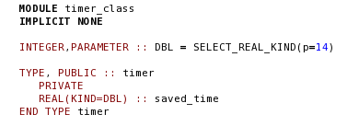
Implementing the timer Class
We’ll define the class in a series of steps:
Define Instance Variables:
Create a single variable called saved_time.
It will contain the last time at which the start_time method was called.
It must be 64-bit.
Create the Methods:
The class must also include two methods to start the timer and to read the elapsed time.

Slide 20
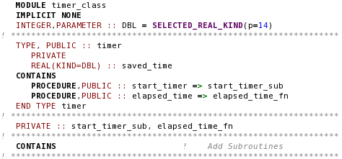
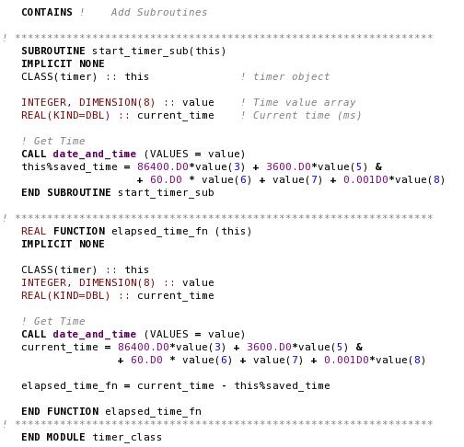
Timer Class

Slide 21
Using the timer Class
To use this class, the programmer must first instantiate a timer object:
This statement defines the object t of the timer class.
The methods can now be called using that reference:
TYPE(timer) :: t
t%start_timer() and t%elapsed_time()

Slide 22
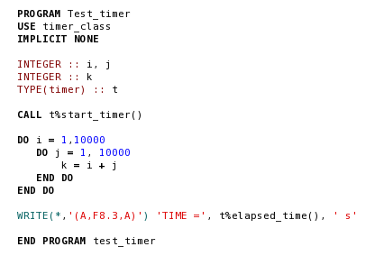
A Program to Test the timer Class

Slide 23
Comments on the timer Class
Any instance variable or method declared with the PUBLIC keyword can be accessed by USE association
Any instance variable or method declared PRIVATE is accessible only to the methods of the object
You should always declare all instance variables to be PRIVATE

Slide 24
Categories of Methods
A class must usually provide a way to store data into, read data from, test the status of and manipulate its instance variables
By convention, names of methods that store data begin with set and are called set methods.
These methods should also check for data validity and consistency.
Names of methods that read data begin with get and are called get methods.
Predicate methods test for the truth or falsity of some condition. They typically begin with is and return a logical result.

Slide 25
Controlling Access to Class Members
Declaring instance variables PRIVATE and methods PUBLIC makes the programs more modular.
The public interface isolates the internals making incremental modification easier.
There are exceptions: Utility methods – PRIVATE methods used to support PUBLIC methods.
Not intended to be called directly by users.

Slide 26
Finalizers
Finalizer - a method called by an object just before it is destroyed.
Performs any cleanup necessary before the object is destroyed.
Bound to a class by adding the FINAL keyword in the CONTAINS section of the type definition
When an item of this data type is destroyed, the final subroutine clean_complex is called automatically.
TYPE, PUBLIC :: complex_ob
PRIVATE
REAL :: re
REAL :: im
CONTAINS
FINAL :: clean_complex
END TYPE complex_ob

Slide 27
Inheritance and Polymorphism
Classes are organized in to a hierarchy.
Lower-level classes inherit variables and methods from higher-level classes.
The class just above a specific class is known as the immediate superclass
Fortran is polymorphic: .
Behavior (methods) defined in a superclass, are:
Automatically inherited by all subclasses unless it is explicitly overridden with a modified method.
A subclass need only to provide methods to implement the differences between itself and its parent.

Slide 28
Superclasses and Subclasses
employee
salaried employee
hourly employee
Objects of either the subclass may be treated as objects of the parent (superclass) class.
Objects of the subclasses can be grouped together and treated as a single collection of objects of the superclass
Objects of both subclasses:
Inherit all PUBLIC instance variables and methods of the parent
If an object is to work with instance variables or override methods defined in the parent, those components must be declared PUBLIC

Slide 29
Defining and Using Subclasses
A class is declared a subclass of another by including an EXTENDS attribute in the type definition.
TYPE, PUBLIC :: employee
! Instance variables
CHARACTER(len=30) :: first_name
CHARACTER(len=30) :: last_name
CHARACTER(len=11) :: ssn
REAL :: pay = 0.0
CONTAINS
! Bound procedures
PROCEDURE, PUBLIC :: set_employee => set_employee_sub
PROCEDURE, PUBLIC :: set_name => set_name_sub
PROCEDURE, PUBLIC :: set_ssn => set_ssn_sub
PROCEDURE, PUBLIC :: get_first_name => get_first_name_fn
PROCEDURE, PUBLIC :: get_last_name => get_last_name_fn
PROCEDURE, PUBLIC :: get_ssn => get_ssn_fn
PROCEDURE, PUBLIC :: calc_pay => calc_pay_fn
END TYPE employee
The employee class

Slide 30
Declaring Salaried_Employee Subclass:
TYPE, PUBLIC, EXTENDS(employee) :: salaried_employee
! Instance variables
PRIVATE
REAL :: salary = 0.0
CONTAINS
! Bound procedures
PROCEDURE, PUBLIC :: set_salary => set_salary_sub
PROCEDURE, PUBLIC :: calc_pay => calc_pay_fn
END TYPE salaried_employee
Inherits all instance variables from class employee
Adds a new instance variable - salary
Inherits all the methods of the parent and:
Adds an new method (set_salary)
Overrides (replaces) method calc_pay with a new version of its own

Slide 31
Declaring Hourly_Employee Subclass:
TYPE, PUBLIC, EXTENDS(employee) :: hourly_employee
! Instance variables
PRIVATE
REAL :: rate = 0.0
CONTAINS
! Bound procedures
PROCEDURE, PUBLIC :: set_pay_rate => set_pay_rate_sub
PROCEDURE, PUBLIC :: calc_pay => calc_pay_fn
END TYPE hourly_employee
Inherits all instance variables from class employee
Adds a new instance variable - rate
Inherits all the methods of the parent and:
Adds an new method (set_pay_rate)
Overrides (replaces) method calc_pay with a new version of its own
Any object of the subclass is an object of the superclass.

Slide 32
Specifying the Employee Class
A complete listing of the Employee class module can be found in you book (pages 796-799)
Calling arguments in each bound method includes the object itself as the first parameter.
Whenever a bound method with the PASS attribute is referenced by an object, obj%method(), the object itself is passed as the method’s first argument.
This allows the method to access or modify the contents of the object if necessary.
The CLASS keyword will work with either and object of class employee or with an object from any subclass
To get polymorphic behavior (i.e. work with subclasses), we must always declare method arguments with the CLASS keyword.
SUBROUTINE set_name_sub (this, first, last)
IMPLICIT NONE
CLASS(employee) :: this
CHARACTER(len=*) :: first
CHARACTER(len=*) :: last
…

Slide 33
Relationship between Superclass Objects and Subclass objects
PROGRAM test_employee
USE hourly_employee_class
USE salaried_employee_class
IMPLICIT NONE
! Declare variables
CLASS(employee), POINTER :: emp1, emp2
TYPE(salaried_employee), POINTER :: sal_emp
TYPE(hourly_employee), POINTER :: hourly_emp
INTEGER istat
! Create an object of type “salaried_employee”
ALLOCATE (sal_emp, STAT=istat)
! Initialize the data in this object
CALL sal_emp%set_employee (‘John’, ‘Jones’,’111-11-111’)
CALL sal_emp%set_salary (3000.00)
! Create an object of type “hourly_employee”
ALLOCATE (hourly_emp, STAT=istat)
CALL hourly_emp%set_employee (‘Jane’, ‘Jones’,’112-11-123’)
CALL sal_emp%set_rate (12.50)
! Create pointers to “employees”
emp1 => sal_emp
emp2 => hourly_emp
! Calculate pay using subclass pointers
WRITE(*,*) ‘Emp 1 Pay =‘, sal_emp%calcu_pay(160.)
WRITE(*,*) ‘Emp 2 Pay =‘, hourly_emp%calcu_pay(160.)
! Calculate pay using superclass pointers
WRITE(*,*) ‘Emp 1 Pay =‘, Emp1%calcu_pay(160.)
WRITE(*,*) ‘Emp 2 Pay =‘, Emp2%calcu_pay(160.)
END PROGRAM
A subclass object may be treated as an object of its superclass.
Objects can be manipulated with pointers to the subclass or to the superclass
An object of a superclass is not an object of its subclass.

Slide 34
Polymorphism
Polymorphism - The ability to automatically select the proper method to apply to each object based on the subclass that object belongs to.
Polymorphism works only when methods are defined in the superclass and overridden in the various subclasses

Slide 35
The SELECT TYPE Construct
A method call like emp1%set_rate( ) is illegal because:
emp1 was declared using CLASS(employee)
It can only see items defined in the declared class
set_rate defined only in the subclass
Using SELECT TYPE gets around this limitation.
Allows explicit determination of the type of subclass an object belongs to, while being referenced with a superclass pointer.

Slide 36
SELECT TYPE Form
The declared type of obj should be the superclass of the other types in the construct.
If the input obj has the dynamic type type1 then
The statements in block 1 are executed.
And the obj pointer will be treated as being type1 during execution.
If the input obj has the dynamic type type2 then
The statements in block 2 are executed.
And the obj pointer will be treated as being type2 during execution.
If the dynamic type of obj does not exactly match any of the TYPE IS clauses then
The structure will look at the CLASS IS clauses
It will execute the code block the provides the best match to the dynamic type of obj.
The obj pointer will be treated as being as the type of declared class during execution.
[name:] SELECT TYPE (obj)
TYPE IS ( type1 ) [name]
Block 1
TYPE IS ( type2 ) [name]
Block 2
CLASS IS ( type3 ) [name]
Block 3
END SELECT [name]

Slide 37
SELECT TYPE Example:
PROGRAM test_select_type
IMPLICIT NONE
! Declare a 2D Point type
TYPE :: point
REAL :: x
REAL :: y
END TYPE point
! Declare a 3D point type
TYPE, EXTENDS(point) :: point3D
REAL :: z
END TYPE point3D
! Declare a 2D point with temp
TYPE, EXTENDS(point) point_temp
REAL :: temp
END TYPE point_temp
! Declare variables
TYPE(point), TARGET :: p2
TYPE(point3d), TARGET :: p3
TYPE(point_temp), TARGET :: pt
CLASS(point), POINTER :: p
! Initialize objects
p2%x = 1
…
! Assign on of the objects to “p”
p=>pt
! Access the data in that object
SELECT TYPE (p)
TYPE IS ( point3d)
WRITE(*,*) p%x, p%y, p%z
TYPE IS ( point_temp)
WRITE(*,*) p%x, p%y, p%temp
CLASS IS ( point )
WRITE(*,*) p%x, p%y
END SELECT
END PROGRAM
pt is declared TYPE point_temp
a subclass of point.
p is declared using the CLASS keyword to be of type point.
Pointer p has a declare type of point.
Target pt has a declared type of point_temp.
So pointer p has a dynamic type of point_temp
The construct will identify the dynamic
type of p and execute the statement block
associated with that type. It also treats p as
type point_temp, allowing access to the
variables and methods defined in that
subclass.

Slide 38
Preventing Methods from being overridden in Subclasses
It is sometimes desirable to ensure that one or more methods are not modified in subclasses of a given superclass.
This is accomplished by declaring them in the binding with the NON_OVERRIDABLE attribute.
Example:
TYPE :: point
REAL :: x
REAL :: y
CONTAINS
PROCEDURE, NON_OVERRIDABLE :: my_proc => my_proc_sub
…
END TYPE

Slide 39
Abstract Classes
For polymorphism to work, polymorphic methods must be bound to the parent class and inherited in all subclasses.
But if you never declare any objects of the parent class, the actual methods in that class may never be used.
Abstract methods, (deferred methods) allow the declaration of bindings and interface definitions, without writing actual methods.
The types containing abstract methods are known as abstract types (as opposed to concrete types).
Abstract methods are declared using the DEFERRED attribute in the type definition and an ABSTRACT INTERFACE to define the calling sequence.
A deferred method is declared with the following statement:
The name in the parentheses after the PROCEDURE declaration is the name of the abstract interface that applies to the method
calc_pay is the actual name of the method.
PROCEDURE (CALC_PAYX), PUBLIC, DEFERRED :: calc_pay

Slide 40
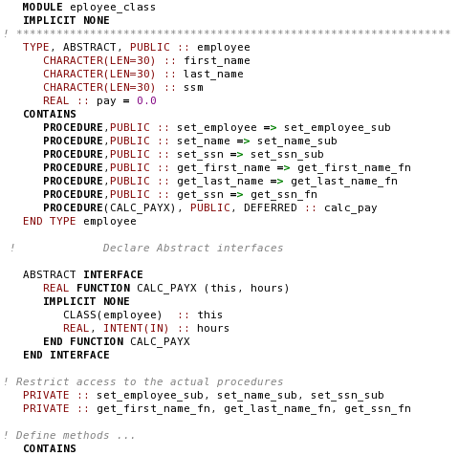
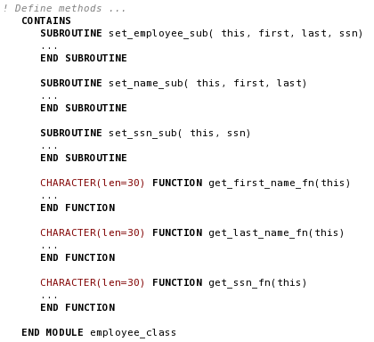
Abstract employee Class

Slide 41
Good Coding Practice
Always make instance variables private
Use SET methods to check validity and consistency of input data
Define predicate methods to test conditions associated with any classes you create
Utilize polymorphism to treat objects of different subclasses as objects of a single superclass.
Declare all polymorphic methods in a common superclass, then override them in each subclass
Use abstract classes to define broad types of behaviors and use concrete subclasses to provide implementation details

